Slide 1
CHICAGO NEIGHBORHOOD ANALYSIS PROJECT
The Development Company
Date: July 14, 2019

Slide 2
Introduction
New Chicago-area Developer, The Development Company (TDC), is looking to determine which up-and-coming neighborhoods are likely to experience enough price appreciation to support new-construction residential housing.
TDC would like to work in the historically underserved South and West areas of the city, but they need to understand the underlying market dynamics in these areas.
TDC’s business plan is looking for neighborhoods where their finished products can sell for at least $200 per square foot and within 120 days of being listed for sale.

Slide 3
Data Acquisition & Cleaning

Slide 4
Data Sources
Data | Link to Data | Use Case to Solve Problem
Chicago Community Area Snapshot Dataset from June 2019 | https://datahub.cmap.illinois.gov/dataset/community-data-snapshots-raw-data | This data set from the Chicago Metropolitan Agency for Planning (CMAP) is a snapshot of demographics for each of Chicago’s 77 neighborhoods. This will allow for obtaining a complete listing of all the neighborhoods in Chicago to conduct analysis activities (i.e. Clustering, Geocoding) at the Neighborhood level.
Google Geocoding API | https://developers.google.com/maps/documentation/geocoding/start | This data source will allow for identifying the center of each Chicago neighborhood for map plotting and retrieval of nearby venues via FourSquare.
FourSquare Explore Venues API | https://developer.foursquare.com/docs/api | This data source will allow for obtaining data on venues in Chicago neighborhoods that are closest to the center of the neighborhood area for a given distance. This will be used to determine what basic features each neighborhood has that may be of interest to potential buyers of TDCs products.
Redfin Data Center - Days on Market & Price Per Square Foot 2012 - 2019 | https://www.redfin.com/blog/data-center/ | This data source will allow for obtaining insights into real estate market activity occurring in the Chicago neighborhoods.

Slide 5
Data Cleaning
CMAP Chicago Community Area Snapshot
The Original CMAP Dataset contained 231 columns of data for each Chicago neighborhood. Using the Data Dictionary from the CMAP Data Hub, MS Excel was used to drop columns deemed least applicable to the analysis of inherent market value. 108 columns were retained as they were the type of data points that would most contribute to inherent market value (i.e. demographics, proportion of owner-occupants to renters, proportion of vacant land to overall land use).

Slide 6
Results & Discussion

Slide 7
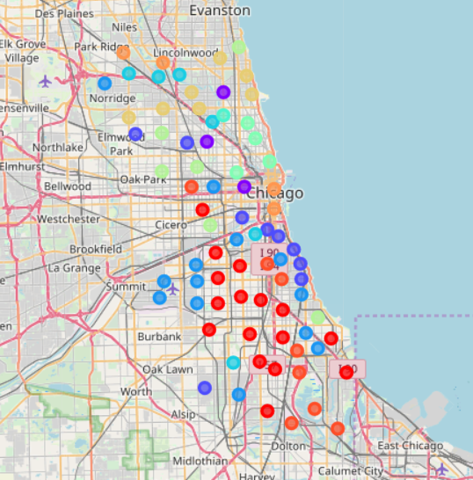
Population Results from K-means Algorithm
The K-Means Algorithm was used to group the 77 Chicago neighborhoods into 11 clusters based on the CMAP data set.
The picture depicts the distribution of the 11 clusters.
The profile of Cluster 2 (Dark Blue) best matched TDC’s business plan and will be used from this point forward.
One observation of note was North Center in Cluster 5 (Aqua Green) that had median home values over $100,000 more in home value than traditionally expensive neighborhood such as Lincoln Park and Lakeview in Cluster 6.

Slide 8
Population Review Results from K-means Algorithm
Cluster # | Cluster Color | Neighborhoods | Cluster Profile
0 | Red | Ashburn Auburn Gresham Brighton Park Chatham Chicago Lawn East Side Englewood Gage Park Greater Grand Crossing New City North Lawndale Roseland South Chicago Washington Heights West Englewood West Pullman | South and Southwest side neighborhoods with low median home values with declining population.
1 | Purple | Lincoln Square Logan Square Near West Side | Northwest and West side neighborhoods with high median home values and increasing population.
2 | Dark Blue | Armour Square Douglas Hermosa Hyde Park Kenwood Lower West Side Montclare Mount Greenwood Oakland | South, Southwest, and Northwest side neighborhoods with moderately high median home values and increasing population.
3 | Medium Blue | Archer Heights Avalon Park Calumet Heights Clearing East Garfield Park Garfield Ridge Grand Boulevard McKinley Park Morgan Park O'Hare West Elsdon West Lawn Woodlawn | Northwest, West, South, and Southwest side neighborhoods with moderately low median home values and increasing population.

Slide 9
Population Results from K-means Algorithm
Cluster # | Cluster Color | Neighborhoods | Cluster Profile
4 | Sky Blue | Avondale Beverly Bridgeport Jefferson Park North Park Norwood Park | Northwest and South side neighborhoods with high median home values and increasing population.
5 | Aqua Green | North Center | North side neighborhood with very high median home values and increasing population.
6 | Light Green | Lake View Lincoln Park Near North Side West Town | North and West side neighborhoods with high median home values and increasing population.
7 | Medium Green | Austin Belmont Cragin Humboldt Park Rogers Park South Lawndale South Shore | North, West, and South side neighborhoods with low median home values and declining population.
8 | Dark Yellow | Albany Park Dunning Edgewater Irving Park Portage Park Uptown West Ridge | North and Northwest side neighborhoods with moderately high median home values and increasing population.
9 | Orange | Edison Park Forest Glen Near South Side The Loop | Northwest, Central, and South side neighborhoods with high median home values and increasing population.
10 | Dark Orange | Burnside Fuller Park Hegewisch Pullman Riverdale South Deering Washington Park West Garfield Park | South and West side neighborhoods with very low median home values and declining population.

Slide 10
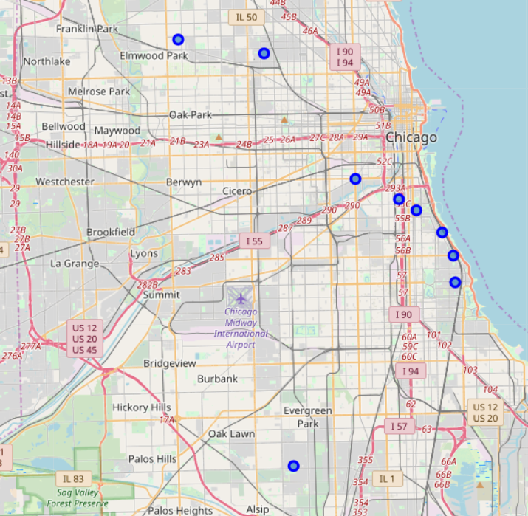
Review of Cluster 2
This picture shows the distribution of the Chicago neighborhoods in Cluster 2: Armour Square, Douglas, Hermosa, Hyde Park, Kenwood, Lower West Side, Montclare, Mount Greenwood, Oakland
In the following slides, we’ll further explore these neighborhoods through visuals

Slide 11
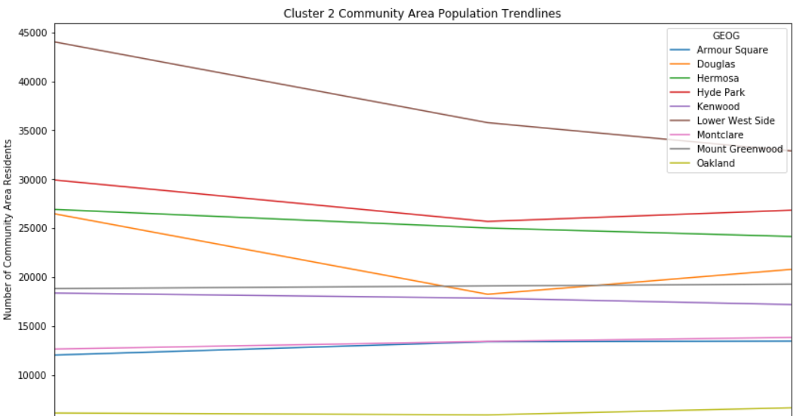

Slide 12
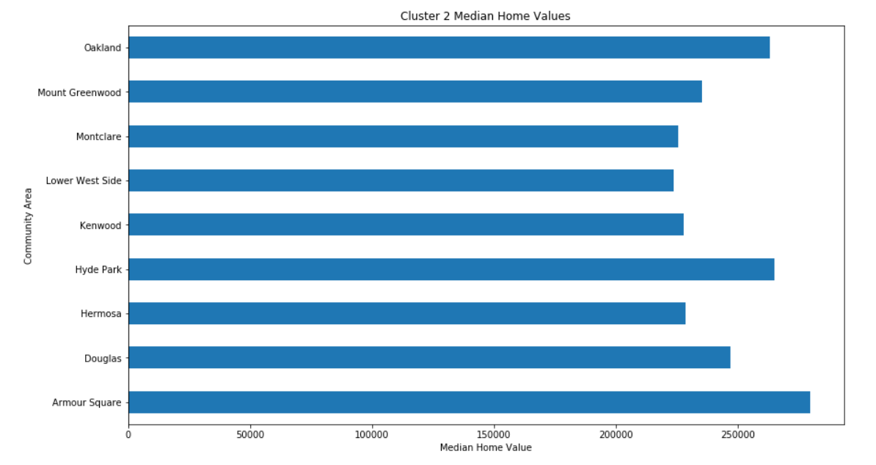

Slide 13
Cluster 2 Exploratory Data Analysis Observations & Recommendations
Neighborhood | Observation | Recommendation
Lower West Side | Downward Trend Line that appears to be due to gentrification and denser housing units being replaced by single-family detached units | Seek to do projects on vacant land before tearing down pre-existing buildings that may have historical significance
Armour Square | Highest median home values in cluster due to either red-line access, access to Guaranteed Rate Field, or both. | Prioritize Armour Square for first projects if the cost of land acquisition is reasonable.

Slide 14
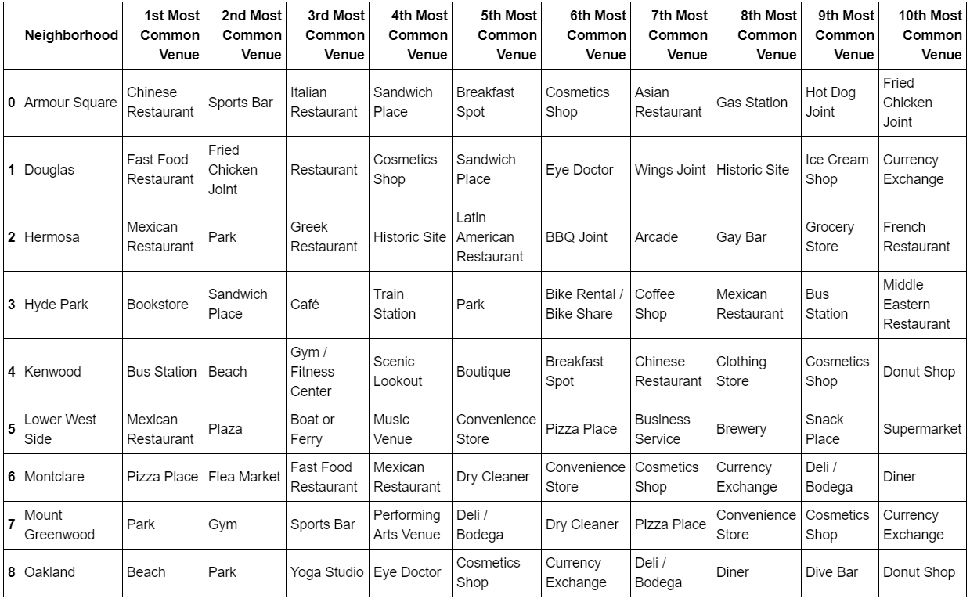
Cluster 2 Neighborhood Deep Dive

Slide 15
Cluster 2 Neighborhood Deep Dive Observations & Recommendations
Neighborhood | Observation | Recommendation
Oakland / Douglas | This neighborhood has features (beach, parks, yoga studios) that can draw in residents with disposable income and lead to new services that require densely populated areas to thrive. | Purchase land in the Douglas neighborhood that sits near the border of Oakland so those development projects can act as “near-prime” housing that draws neighborhood rebuilding activities westward.

Slide 16
Cluster 2 Neighborhood Real Estate Analysis
The following section will present Box Plots of Price Per Square Foot & Days On Market for the entire cluster and a trend line chart for the Top 3 neighborhoods, for each property type, that best met TDC’s business plan.
The Box Plots and Trend Line charts for each property type is followed up by a table which recommends priority of neighborhoods and is supported by estimated sales price and days on market

Slide 17
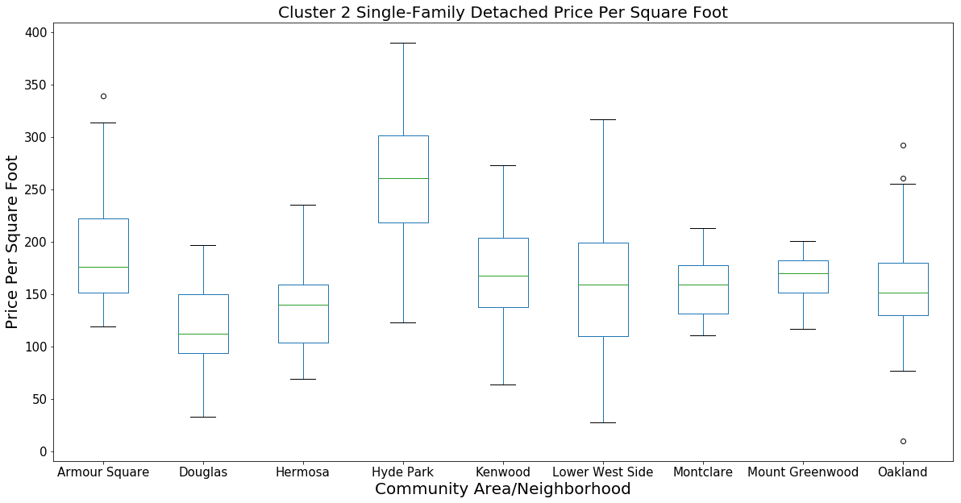

Slide 18
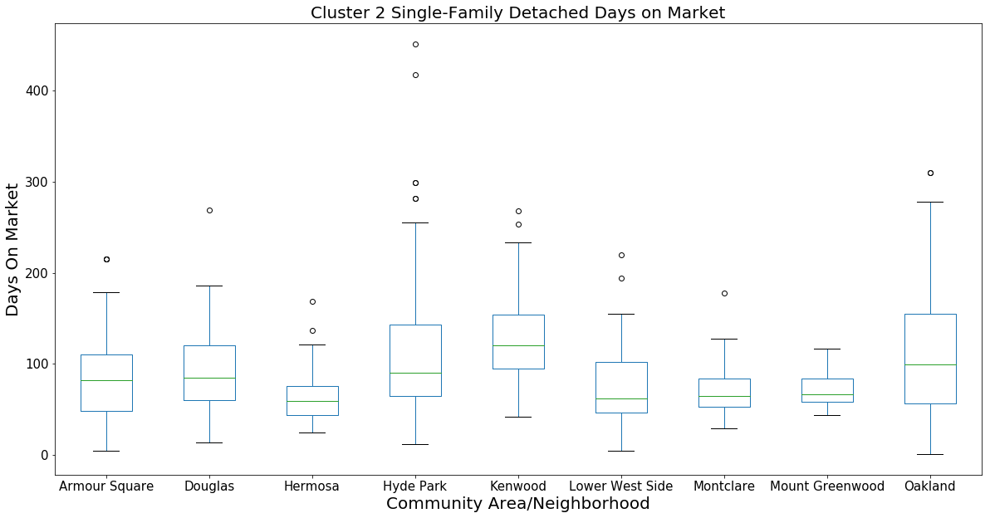

Slide 19
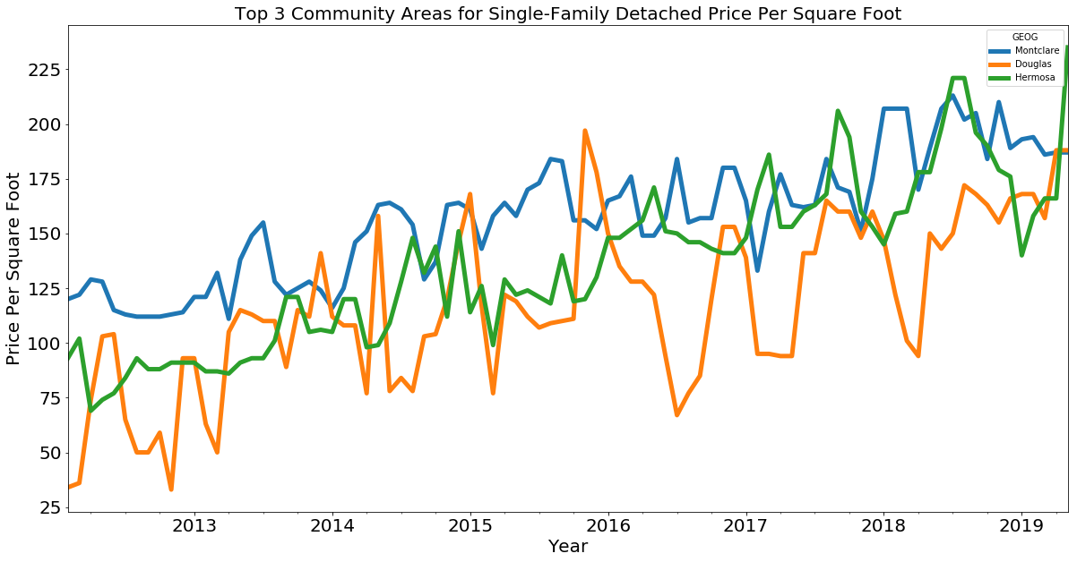

Slide 20
Top 3 Neighborhoods for Single Family Detached Units Analysis (Based on a 3000 Sq. Ft. Home)
Priority | Neighborhood | Estimated Sales Price | Estimated Days on Market
1 | Hermosa | $681,000 @ $227/sq. ft. | 150
2 | Douglas | $562,500 @ $187.5/sq. ft. | 150
3 | Montclare | $562,500 @ $187.5/sq. ft. | 200

Slide 21
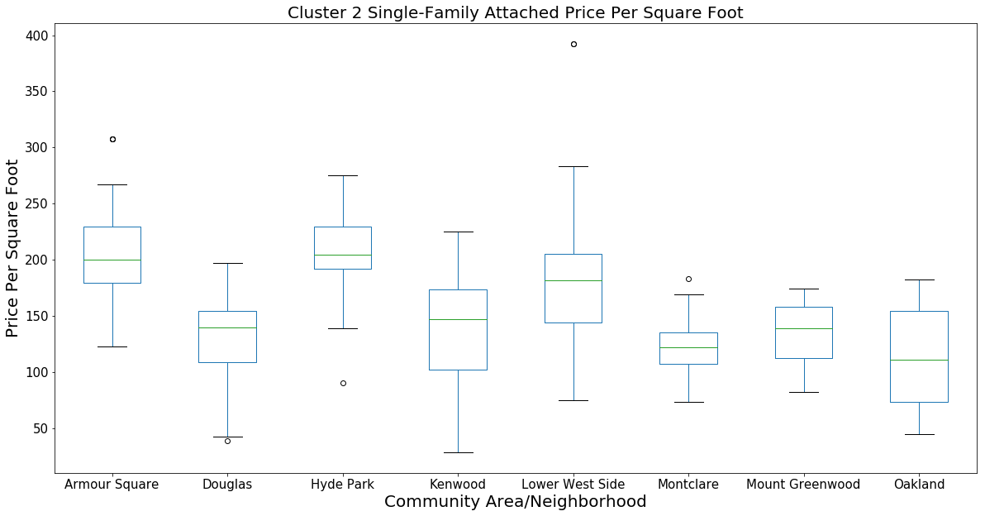

Slide 22
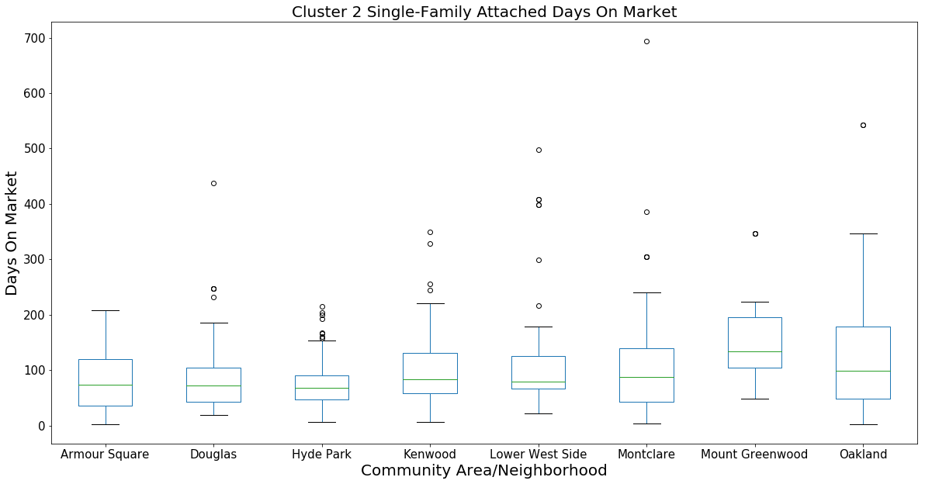

Slide 23
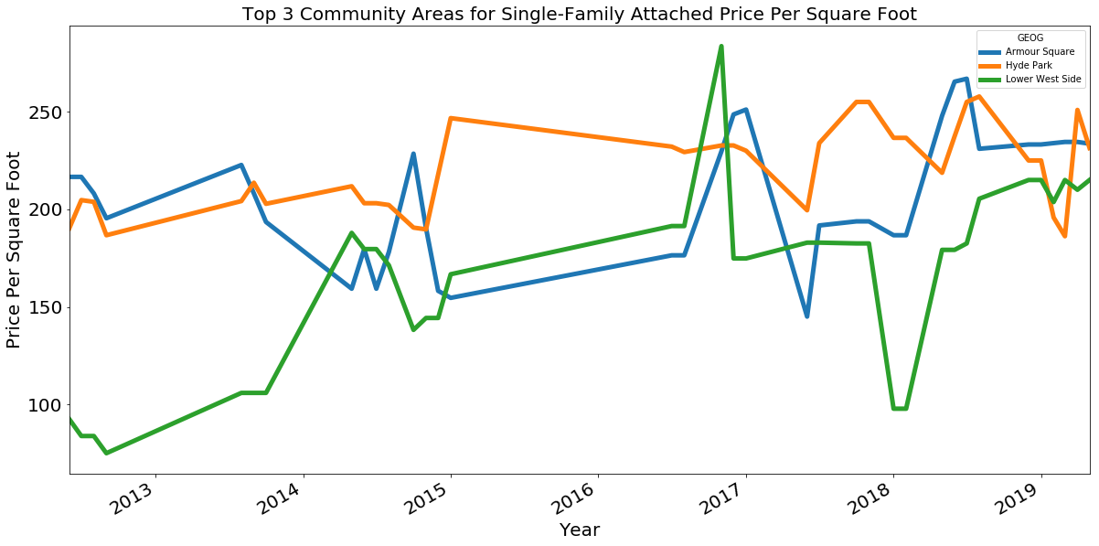

Slide 24
Top 3 Neighborhoods for Single Family Attached Units Analysis (Based on a 2400 Sq. Ft. Home)
Priority | Neighborhood | Estimated Sales Price | Estimated Days on Market
1 | Armour Square | $576,000 @ $240/sq. ft. | 150
2 | Hyde Park | $576,000 @ $240/sq. ft. | 150
3 | Lower West Side | $528,000 @ $220/sq. ft. | 150

Slide 25
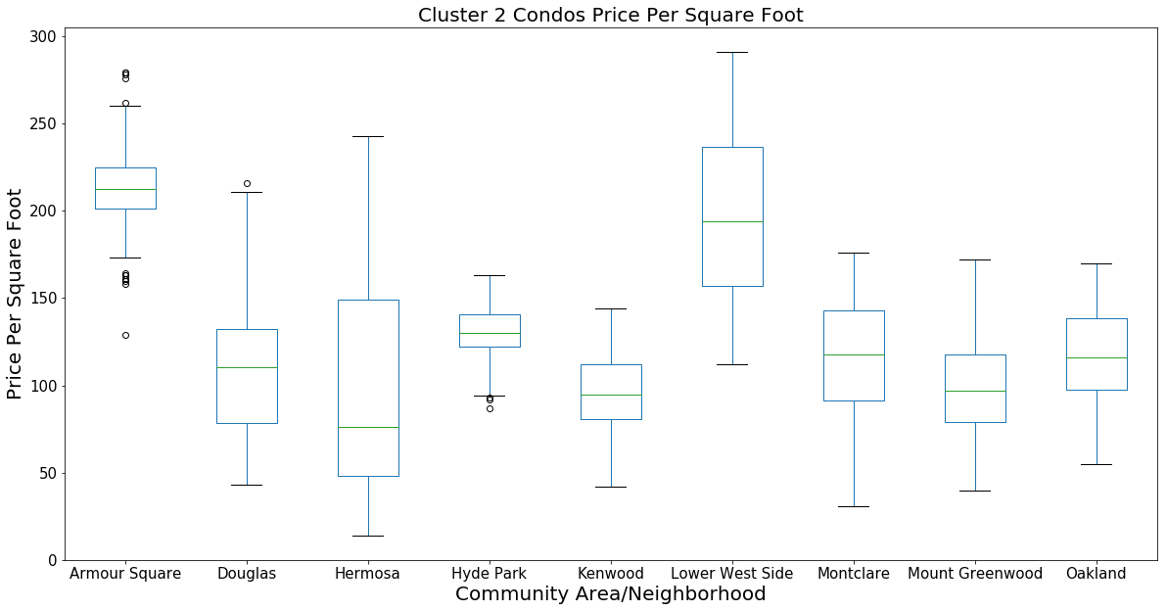

Slide 26
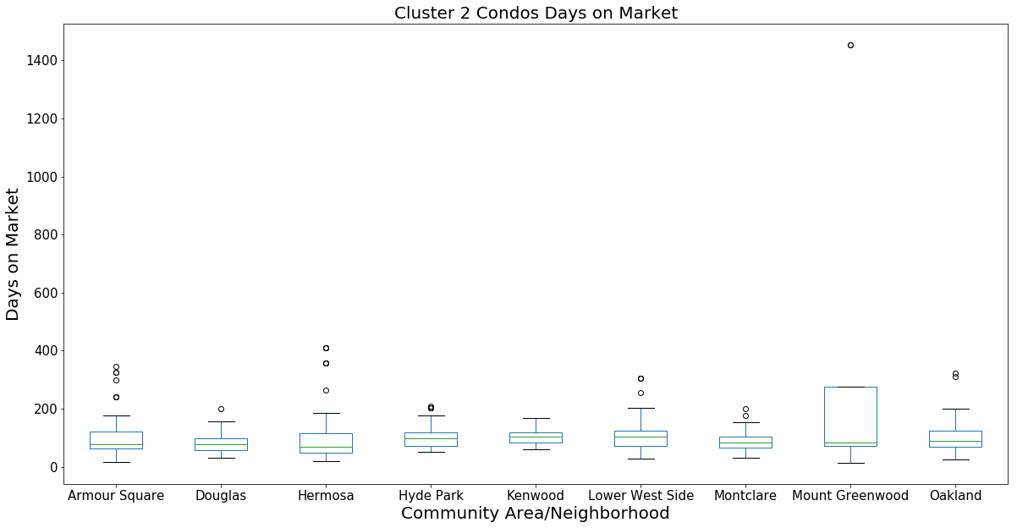

Slide 27
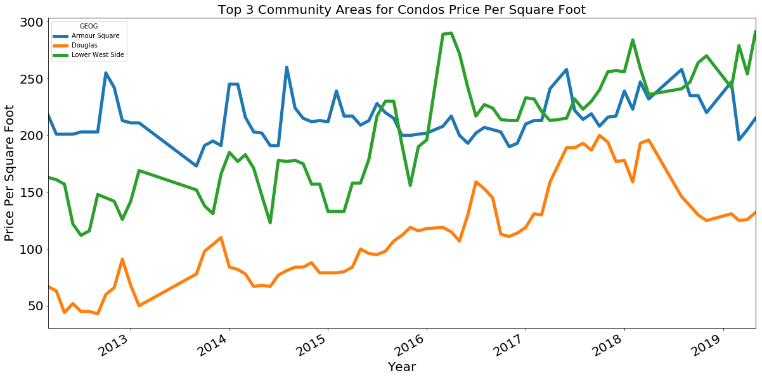

Slide 28
Top 3 Neighborhoods for Condo Units Analysis (Based on a 1200 Sq. Ft. Home)
Priority | Neighborhood | Estimated Sales Price | Estimated Days on Market
1 | Armour Square | $252,000 @ $210/sq. ft. | 120
2 | Lower West Side | $336,000 @ $280/sq. ft. | 120
3 | Douglas | $168,000 @ $140/sq. ft. | 90

Slide 29
Conclusion

Slide 30
Closing Thoughts
Investment in near-prime South and West-side neighborhoods can yield good profit potential while delivering community benefits.
Utilizing the popularity of Oakland and Armour Square to re-densify Douglas can be a good investment for Developers (i.e. increasing profit potential) and bring higher-quality services to neighborhood residents.

Slide 31
Future Projects
Logistic Regression models taking in market data for the Cluster 2 neighborhoods and predicts estimated sales price of finished products.

